Slide 1
How to create an ALTO "dialect"
ALTO Board, 2014

Slide 2
ALTO dialects
Libraries often need to adapt the ALTO schema.
These local formats generally include minor changes to the LoC schema, in order to fulfill specific needs. These differences can be:
new attributes
patterns added on attributes
attributes or elements made mandatory
restraints on enumeration
…

Slide 3
Local overriding needs
Objectives : Let an ALTO producer redefining/overriding
some parts of the ALTO schema, considering that the “copy and hack schema” solution must be avoided.
Implementation : W3C XML Schema provides a mechanism for updating a type definition. The updated type derives from itself. This mechanism is based on the xs:redefine element, which first acts as an xs:include element. Then, the included types can be redefined, with two mechanisms:
Restriction: adding some constraints on existing types
Extension: creating new elements or attributes

Slide 4
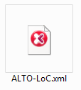
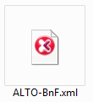
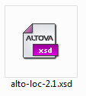
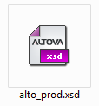
Principle
If only restrictions are used, ALTO “dialect” contents are also valid ALTO-LoC contents.
ALTO dialects can’t be intercompatible: they have different restrictions.
Content
Schemas
ALTO-LoC
ALTO-Dialect
Extensions ruins compatibility…

or 
inherits from
ALTO-LoC
is valid relatively to
❒

ALTO dialect

Slide 5
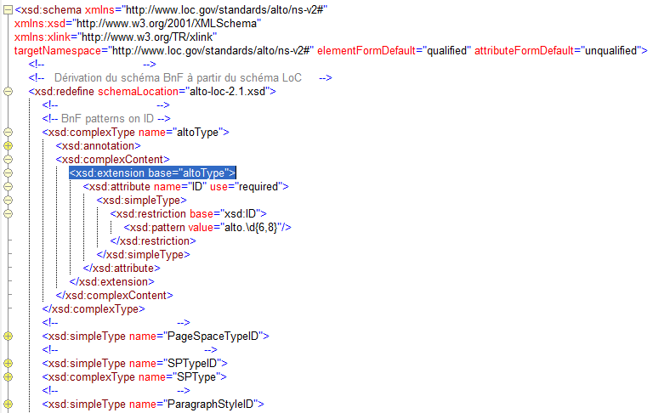
Principle
The following example shows how a library can update the ALTO schema in order to add a specific attribute (ID).
Link to the ALTO-LoC schema
Adding a new type
The base type which is extended
Other base types to be redefined

Slide 6
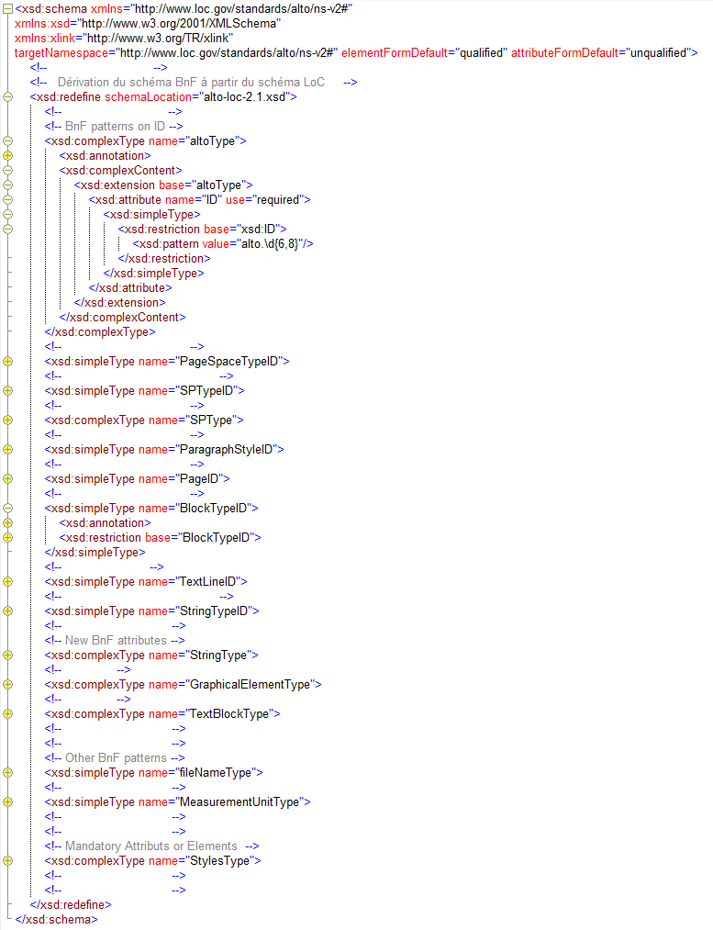
BnF example
New attributes: 3
Patterns added on attributes: 8
Attributes or elements made mandatory: 2
Restraints on enumeration: 1

Slide 7
Conclusion
Benefits
Use of a (relatively) simple XML schema mechanism to implement local needs/controls. These kind of controls could be implemented with other tools (programing languages, Schematron, etc.), but these tools are more complex to handle for small/medium institutions.
Avoid the dialects syndroma: the institutions stay attached to the ALTO-LoC schema and only refine minor parts of the schema.
The differences between an ALTO dialect and the ALTO LoC (or between two ALTO dialects), are clearly documented by the schema design: all the differences are listed in the schema itself!

Slide 8
Conclusion
Drawbacks
The xsd:refine mechanism needs named types. Consequently, the extended schema (ALTO LoC) will need some reengineering before
the xsd:refine mechanism can be applied.
There are some limitations:
  Restriction and extension can’t be used on a type at the same time.
  The name space of the redefined schema must be the ALTO LoC name space. In the BnF case, the old local name space must be dropped, and consequently the redefined schema is not backward compatible with old ALTO files (although the content itself is).
Some institutions could use this mechanism to create a new ALTO format (by adding new elements or new attributes): some benefits of this design are lost. Need for extensions should be submitted to the ALTO board first.

